Slide 1



MEMORY
Miss Aisha Bano
aisha.bano@nu.edu.pk

Slide 2

Memory
The ability to retain knowledge
(Cacioppo & Freberg, 2013)
The process by which we encode, store, and retrieve information. (Feldman, 2011)
Information Processing
A continuum including attention, sensation, perception, learning, memory and cognition.

Slide 3



Memory Processes
3 R ’s of Memory
01
Recording
(encoding)
Retrieval
(recall)
Retention
(storage)
03
02

Slide 4

Recording
(ENCODING)
The process of transforming information into a form that can be entered and retained in the memory system.
The process of transforming the information from one form to another is called recording.
(Feldman, 2011)
start now
information

Slide 5

Retention
(STORAGE)
The process of retaining information in memory so that it can be used later.
The process of storing the information is called retention.
(Feldman, 2011)
start now
information

Slide 6

Retrieval
(RECALL)
The process of recovering information stored in memory so that we are consciously aware of it.
The recovery of stored information is called retrieval. (Feldman, 2011)
start now
information

Slide 7
Cognitive Map theory by Edward Tolman (1948)
This theory is about memory systems (code, store, recall and decode)
A Cognitive Map is any visual representation of a person’s (or a group’s) mental model for a given process or concept.
The influential cognitive map theory proposes that memories of recently travelled routes are combined with memories of previously travelled routes to create an integrated map of the environment.

Slide 8
THREE STAGES OF MEMORY
Three memory stores that differ in function, capacity and duration are :
01
02
03
Sensory
memory
Short-term
memory
Long-term
memory
(also called working memory)

Slide 9
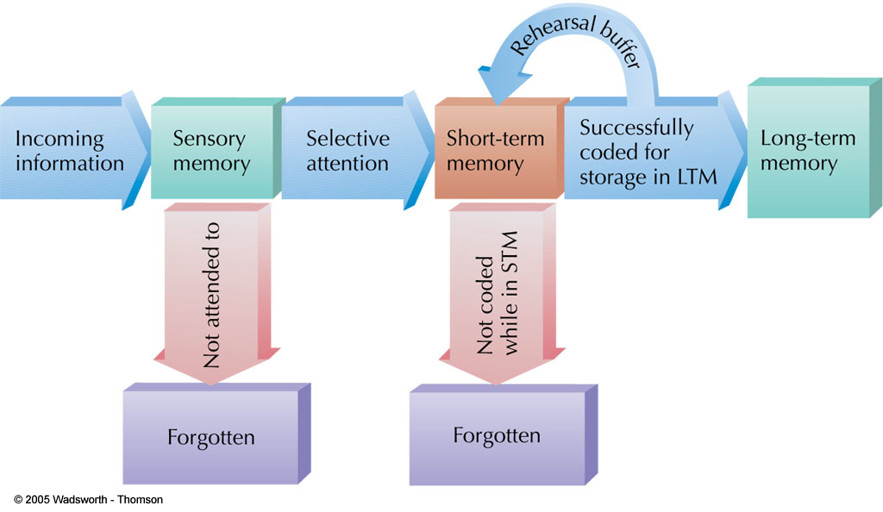
TYPES / STAGES OF MEMORY

Slide 10


1. Sensory Memory
The first stage of A-S (Atkinson-Shiffrin) model that holds large amounts of incoming data for very brief amounts of time. (Cacioppo & Freberg, 2013)
The initial, momentary storage of information, lasting only an instant.
(Feldman, 2011)

Slide 11
Sensory Memory
Function : process for basic physical characteristics
Capacity : large
can hold many items at once
Duration : very brief retention of images
3 sec for visual info
2 sec for auditory info
Divided into two types:
iconic memory–visual information
echoic memory– auditory information
Attention is needed to transfer information to working memory
Sensory
Memory
Sensory
Input

Slide 12

2. Short-Term Memory
(STM) /( Working Memory)
The second stage of A-S model that holds a small amount of information for a limited time. (Cacioppo & Freberg, 2013)
Memory that holds information for 15-25 seconds called STM. (Feldman, 2011)

Slide 13
3. Short-Term Memory
(STM) /( Working Memory)
Function : conscious processing of information
where information is actively worked on
Capacity : limited (holds 7+/-2 items)
Duration : brief storage (about 25 Sec)
Sensory
Memory
Working or
Short-term
Memory
Sensory
Input
Attention

Slide 14
Maintenance Rehearsal of STM
Maintenance
Rehearsal
Sensory
Memory
Working
or
Short-term
Sensory
Input
Attention

Slide 15

CHUNKING
A meaningful grouping of stimuli that can be stored as a unit in Short Term Memory. (Feldman, 2011)
The process of grouping similar or meaningful information together.
(Cacioppo & Freberg, 2013)
Chunks expand working memory load

Slide 16
ACTIVITY
Which is easier to remember?
4 8 3 7 9 2 5 1 6
483 792 516
t h e o c e a n i s b l u e a n d b e a u t i f u l
The ocean is blue and beautiful

Slide 17

Long-Term Memory (LTM)
The final stage of the A-S Model that is the location of permanent memory.
(Cacioppo & Freberg, 2013)
Memory that stores information on a relatively permanent basis, although it may be difficult to retrieve. (Feldman, 2011)
start now
information

Slide 18
Long-Term Memory (LTM)
Once information passes from sensory to working memory, it can be encoded into long-term memory.
Function—LTM
organizes and stores information
more passive form of storage than working memory
Capacity: Unlimited
Duration—Relatively permanent
start now
information

Slide 19

Maintenance Rehearsal of LTM
Maintenance Rehearsal
Sensory
Memory
Working
or
Short-term
Long Term
Memory
Attention
Encoding
Sensory
Input
Retrieval

Slide 20
Long-Term Memory (LTM)
Encoding—process that controls movement from working to long-term memory store
Retrieval—process that controls flow of information from long-term to working memory store

Slide 21

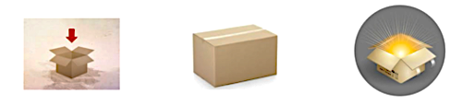
Long-Term Memory (LTM)
Encoding
Storage
Retrieval

Slide 22
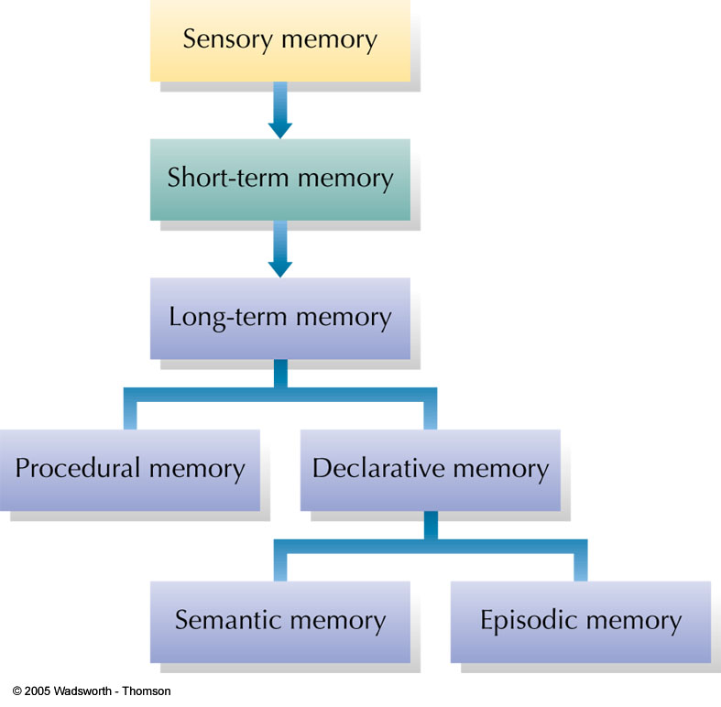
Classification Model of Memory
In the model shown here, long-term memory is divided into procedural memory (learned actions and skills) and declarative memory (stored facts).
Declarative memories can be either semantic (impersonal knowledge) or episodic (personal experiences associated with specific times and places).

Slide 23
Types of Long-term Memory
Declarative memory
memory with awareness.
information can be consciously recollected
Also known as Explicit memory
Non-Declarative memory/Procedural memory
memory without awareness.
Memory that affects behavior but cannot consciously be recalled
Also known as Implicit memory

Slide 24
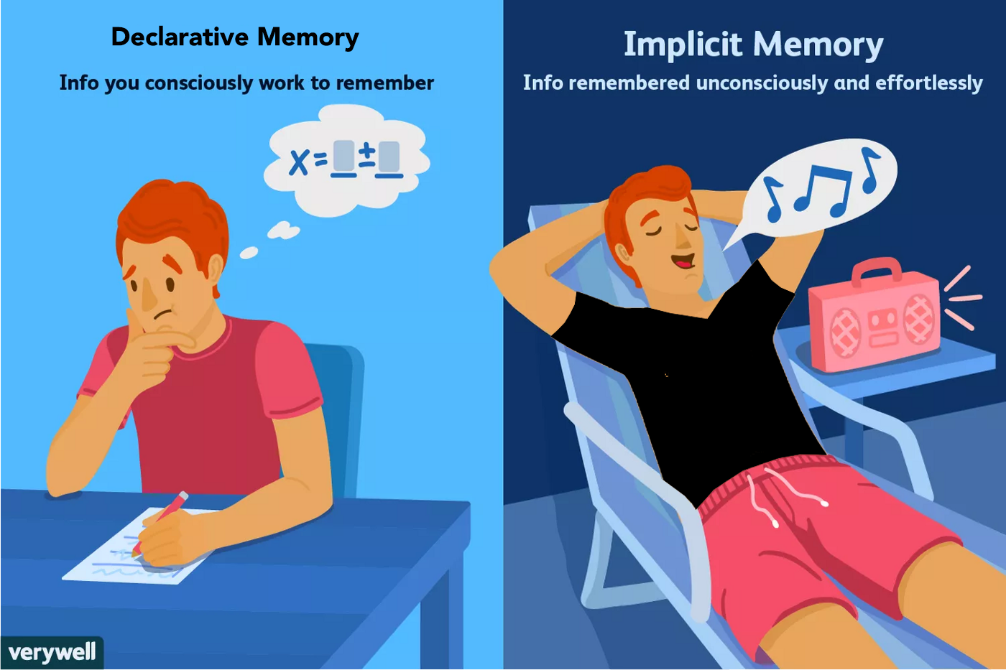
Non-Declarative memory

Slide 25
1: Declarative Memory (Explicit memory)
Information based on facts.
Memory consciously recalled or declared.
Can use explicit memory to directly respond to a question
Two subtypes of declarative memory
Semantic memory
Episodic memory

Slide 26
Type of Declarative Memory
i. Semantic Memory
(General memory)
Information about impersonal facts and general knowledge
e.g., North is cold and beautiful
Memory not tied to personal events.
General facts and definitions about the world.
Examples:
Usually, a car has four wheels.
Color of strawberry is red and it’s useful for health
Does NOT depend on tying the item to your past.

Slide 27
Type of Declarative Memory
ii. Episodic Memory
(Personal knowledge)
Information about events or “episodes”.
Memory tied to your own personal experiences.
General facts and definitions about the world
Examples:
Remembering your visit to any picnic place.
Birthday or wedding ceremony.
Your birth month.
Your best memory till date.

Slide 28
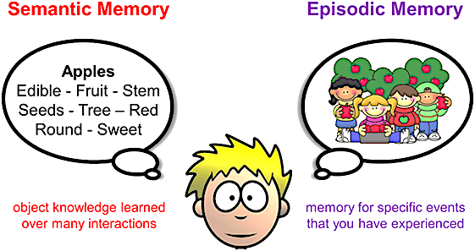
Types of Declarative Memory

Slide 29




2: Non-Declarative Memory
(Procedural Memory)
Memory that enables a person to perform specific learned skills or habitual responses.
Don’t have to consciously remember the steps involved in the actions to perform them.
Examples
02
04
01
03
Riding a
bike
Knowing
how to swim.
Using the shift stick while driving.
Tying your
shoelaces.

